Slide 1
BITS Pilani presentation
Mridul Moitra
Cloud Computing

Slide 2
<CSI ZG527 / SS ZG527 / SE ZG527
Cloud Computing
Lecture No. 2

Slide 3
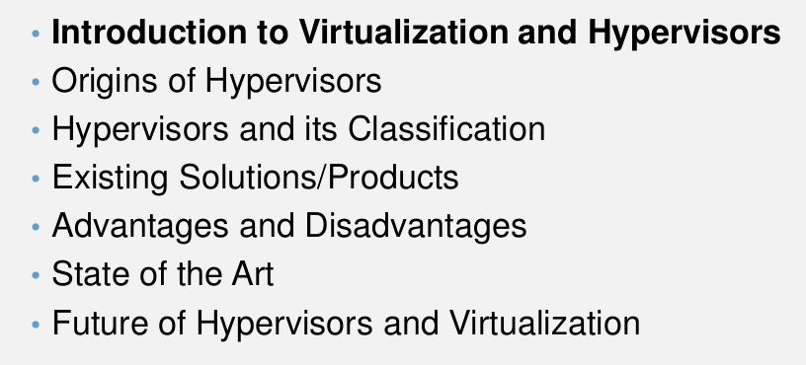
Overview

Slide 4
Introduction
Virtualization is the simulation of the software and/or
hardware upon which other software runs. This
simulated environment is called virtual machine. Each
VM can run its own operating systems and
applications as if it were in a physical machine. So It is
way to run multiple operating systems on the same
hardware at the same time.
▪ For e.g., Windows and Linux both can run on the same
laptop at the same time

Slide 5
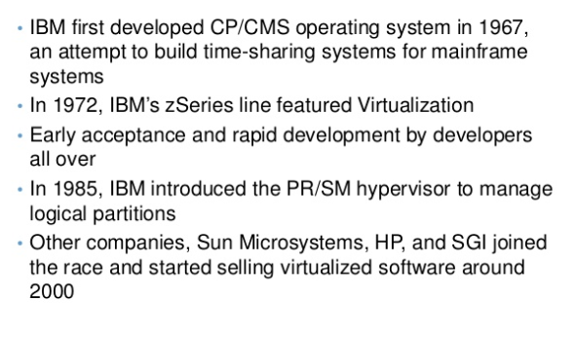
Origin of Hypervisor

Slide 6
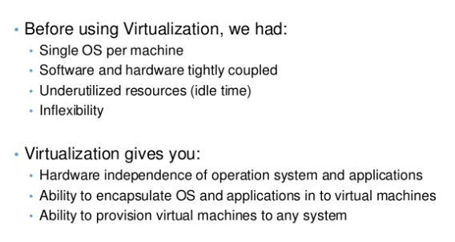
What is Virtualization

Slide 7
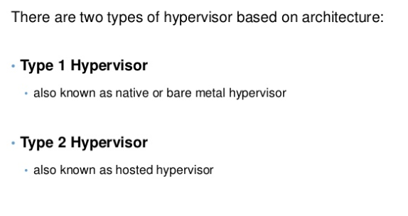
Classification of Hypervisors

Slide 8
Technology made cloud possible
Key Technology is Virtualization
App
App
App
App
App
App
OS
OS
OS
Operating System
Hypervisor
Hardware
Hardware
Traditional Stack
Virtualized Stack
Virtualization plays an important role as an enabling technology for datacentre implementation by abstracting compute, network, and storage service platforms from the underlying physical hardware
Notes:
RL 2.1
Virtualization is simulating a hardware platform, operating system, storage device or network resources

Slide 9
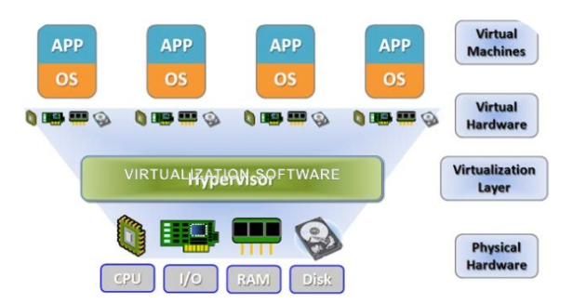
What is Virtualization

Slide 10
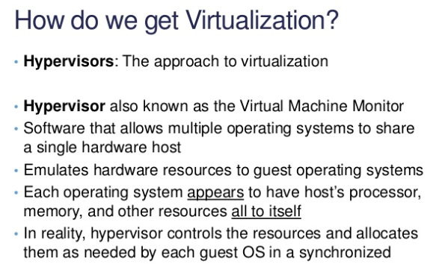
How do we Get Virtualization

Slide 11
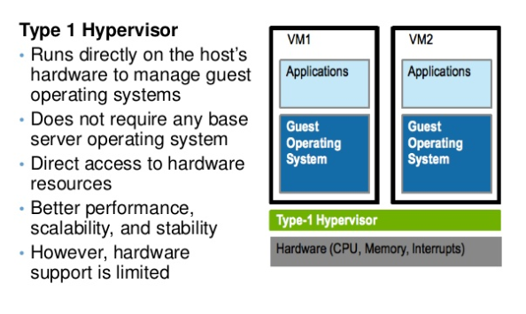
Classification of Hypervisors

Slide 12
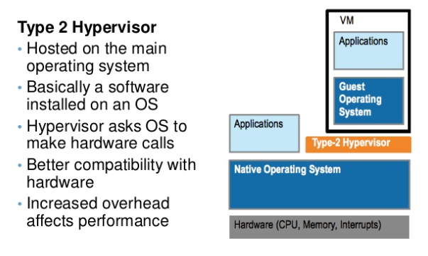
Classification of Hypervisor

Slide 13
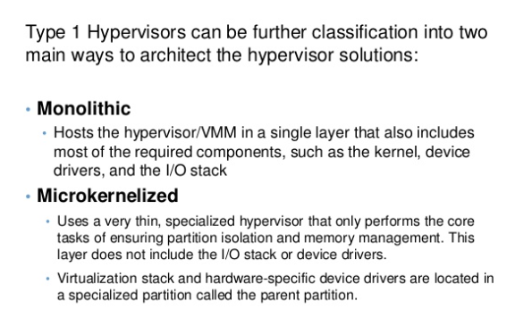
Classification of type I VMM

Slide 14
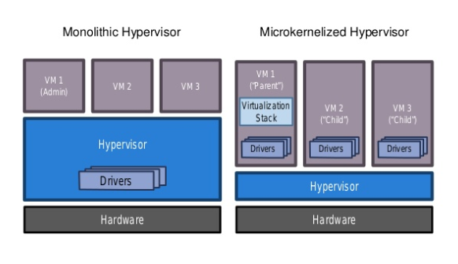
Classification of Type I VMM

Slide 15
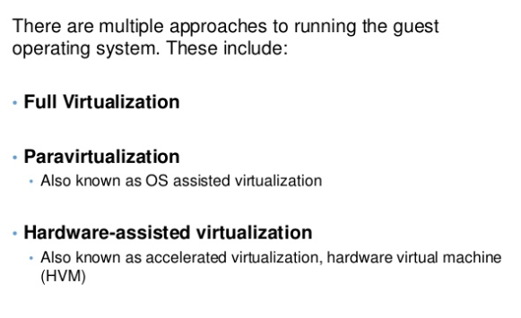
Virtualization Techniques

Slide 16
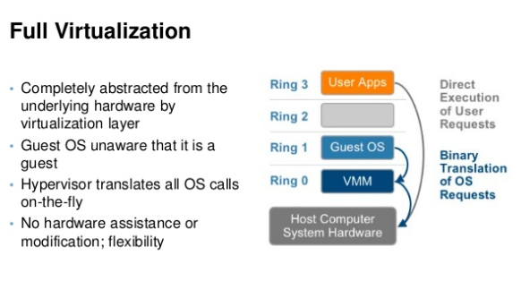
Virtualization Techniques

Slide 17
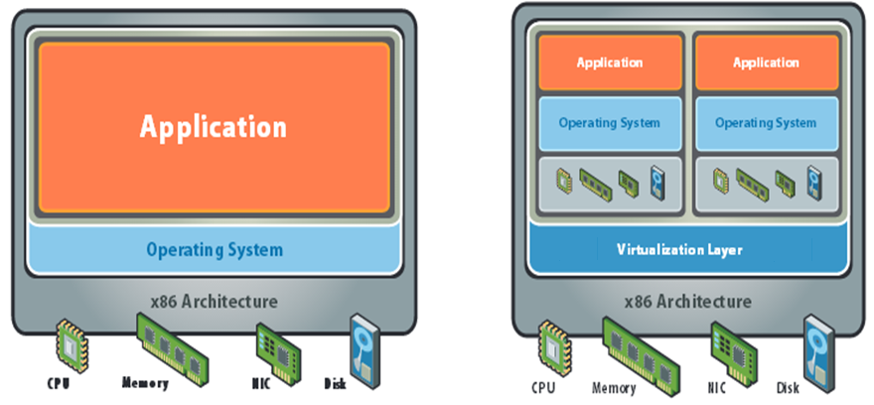
What is Virtualization

Slide 18
Importance of Virtualization in
Cloud Computing
Cloud makes notion of “Pay for what you use”, “infinite availability- use as much you want”.
These notions are practical only if we have
lot of flexibility
efficiency in the back-end.
This efficiency is readily available in Virtualized Environments and Machines

Slide 19
What does Virtualization do?
Virtualization allows multiple operating system instances to run concurrently on a single computer
It is a means of separating hardware from a single operating system.
Each “guest” OS is managed by a Virtual Machine Monitor (VMM), also known as a hypervisor.
Because the virtualization system sits between the guest and the hardware, it can control the guests’ use of CPU, memory, and storage, even allowing a guest OS to migrate from one machine to another.
Instead of purchasing and maintaining an entire computer for one application, each application can be given its own operating system, and all those operating systems can reside on a single piece of hardware.
Virtualization allows an operator to control a guest operating system’s use of CPU, memory, storage, and other resources, so each guest receives only the resources that it needs.

Slide 20
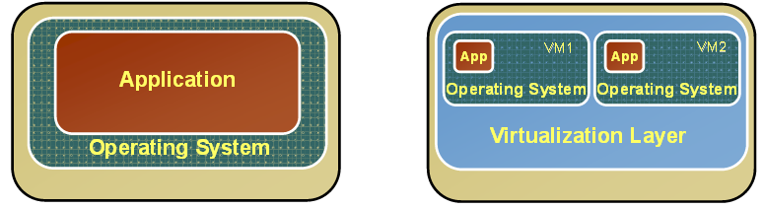
Changes after Virtualization
Before Virtualization
After Virtualization
Single OS image per machine
Software and hardware tightly coupled
Running multiple applications on same machine often creates conflict
Underutilized resources
Inflexible and costly infrastructure
• Hardware-independence of operating system and applications
• Virtual machines can be provisioned to any system
• Can manage OS and application as a single unit by encapsulating them into virtual machines

Slide 21
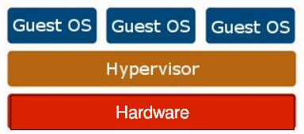
Virtualization Architecture
OS assumes complete control of the underlying hardware.
Virtualization architecture provides this illusion through a hypervisor/VMM.
Hypervisor/VMM is a software layer which:
Allows multiple Guest OS (Virtual Machines) to run simultaneously on a single physical host
Provides hardware abstraction to the running Guest OSs and efficiently multiplexes underlying hardware resources

Slide 22
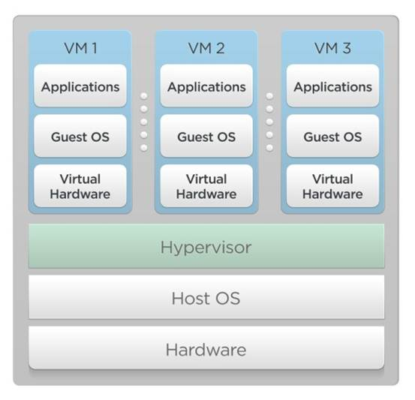
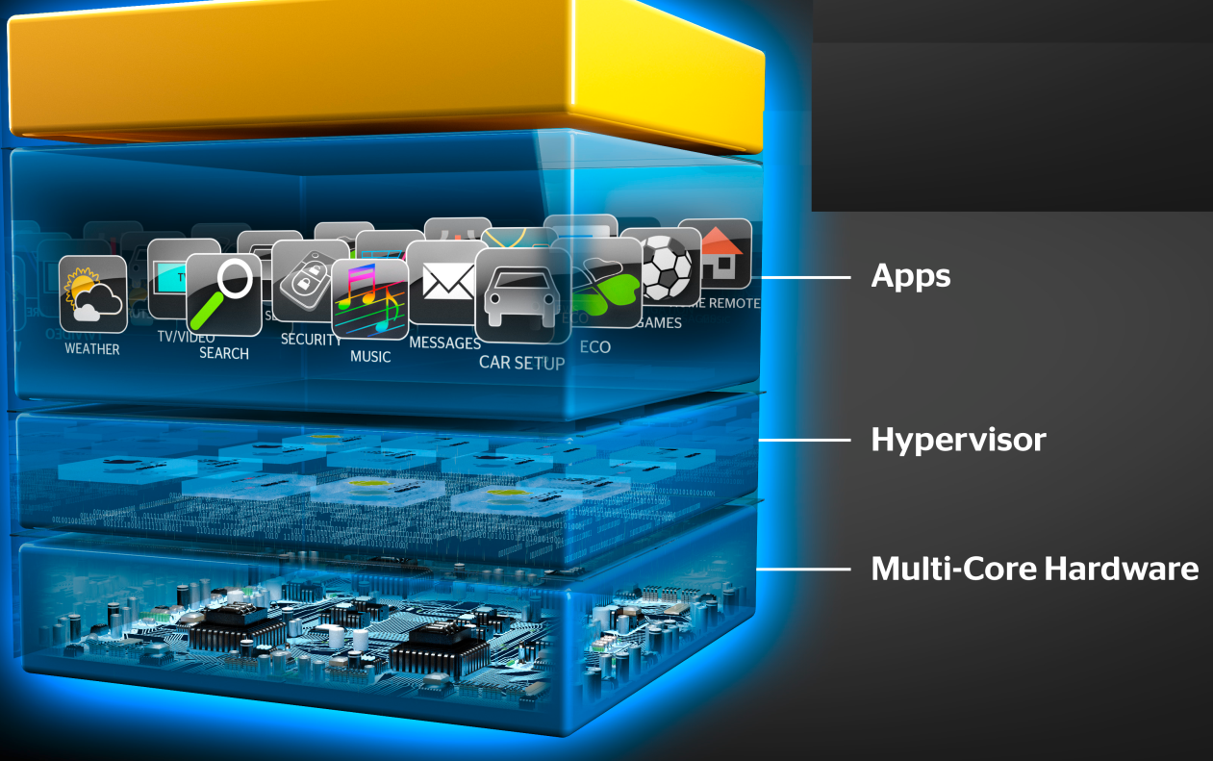
Hypervisor
A thin layer of software that generally provides virtual partitioning capabilities which runs directly on hardware, but underneath higher-level virtualization services. Sometimes referred to as a “bare metal” approach.
Notes:
RL 2.2

Slide 23
Hypervisor Design Goals
Isolation
Security isolation
Fault isolation
Resource isolation
Reliability
Minimal code base
Strictly layered design
Not extensible
Scalability
Scale to large number of cores
Large memory systems

Slide 24
How Hypervisor goals are achieved?
Partitioning Kernel
“Partition” is isolation boundary
Few virtualization functions; relies on virtualization stack
Very thin layer of software
Microkernel
Highly reliable
Basis for smaller Trusted Computing Base (TCB)
No device drivers
Drivers run in a partition
Well-defined interface
Allow others to create support for their OSes as guests

Slide 25
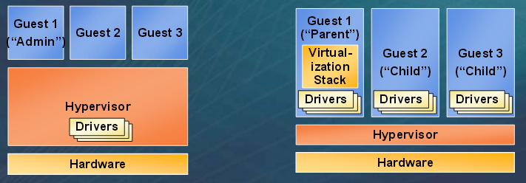
Hypervisor
Monolithic versus Microkernelized
Monolithic hypervisor
Simpler than a modern kernel, but still complex
Contains its own drivers model
Microkernelized hypervisor
Simple partitioning functionality
Increase reliability and minimize lowest level of the TCB
No third-party code
Drivers run within guests

Slide 26
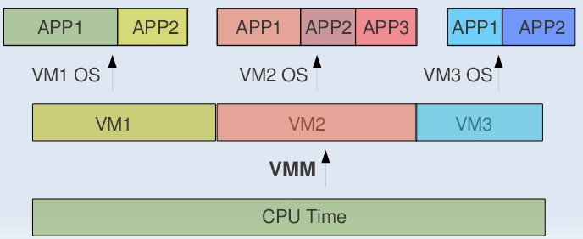
CPU Sharing
VMM or Hypervisor provides a virtual view of CPU to VMs.
In multi processing, CPU is alloted to the different processes in form of time slices by the OS.
Similarly VMM or Hypervisor allots CPU to different VMs.

Slide 27
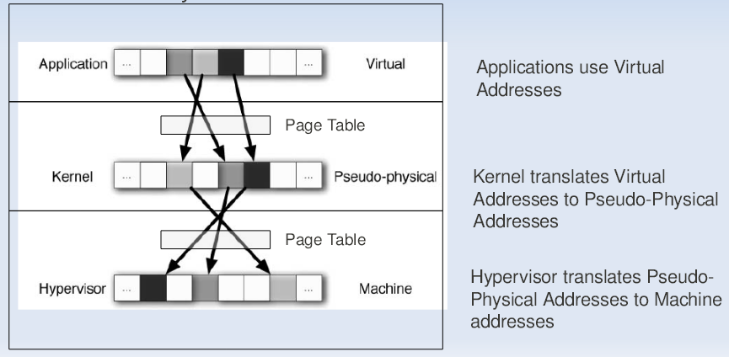
Memory Sharing
In Multiprogramming there is a single level of indirection maintained by Kernel.
In case of Virtual Machines there is one more level of indirection maintained by VMM

Slide 28
IO Sharing
Device needs to use Physical Memory location.
In a virtualized environment, the kernel is running in a hypervisor-provided virtual address space
Allowing the guest kernel to convey an arbitrary location to device for writing is a serious security hole
Each device defines its own protocol for talking to drivers

Slide 29
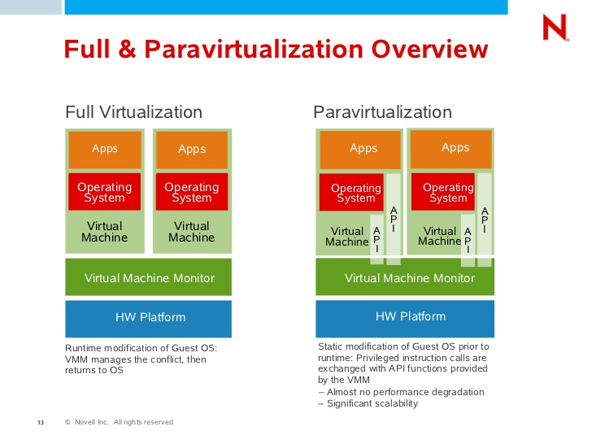
Approaches for Virtualization
Notes:
RL 2.3

Slide 30
Full Virtualization
Full virtualization
In its basic form known as “full virtualization” the hypervisor provides a fully emulated machine in which an operating system can run. VMWare is a good example.
The biggest advantage to this approach is its flexibility: one could run a RISC-based OS as a guest on an Intel-based host.
While this is an obvious approach, there are significant performance problems in trying to emulate a complete set of hardware in software.

Slide 31
VM Implementation Techniques
Binary Translation
Paravirtualization
Hardware Supported Virtualization

Slide 32
Binary Translation
Used in VMWare
Binary image of OS is manipulated at the runtime.
Privileged instructions are rewritten to point to their emulated versions.
Performance from this approach is not ideal particularly when doing anything I/O intensive.
Caching of the locations of unsafe instructions can speed Up

Slide 33
Paravirtualization
Used in XEN
Make OS aware of underlying Virtualization env.
OS's code is manipulated.
Important system calls are changed to point to the implementation provided by the VMM.

Slide 34
HW Supported Virtualization
Added new instructions which makes Virtualization considerably easier for x86.
Intel – IVT(Intel Virtualization Technology)
AMD – introduced AMD-V
OS stays in its original privilege level 0.
Attempts to access the hardware directly are caught and passed to VMM.
In other words a new privilege ring is setup for the VMM

Slide 35
XEN
XEN Domains
CPU Sharing
Hyper Calls
Memory Sharing
IO Sharing
XEN Split Driver Technique
IO Ring

Slide 36
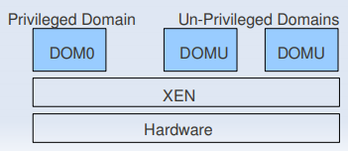
XEN Domains
Xen runs guests in environments known as domains which encapsulate a
complete running virtual environment
There are two types pf Domains:
DomU -the “U” stands for unprivileged.
Guest OSs run in this domain.
Dom0 has elevated privileges
Provides device drivers
Provides tools/mechanisms to configure Virtualization environment

Slide 37
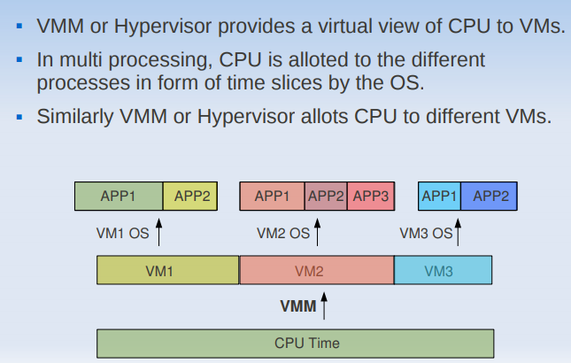
CPU Sharing

Slide 38
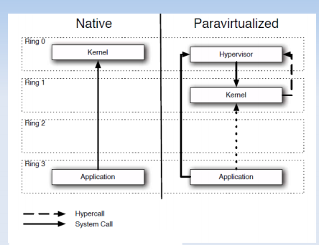
XEN Hypercall

Slide 39
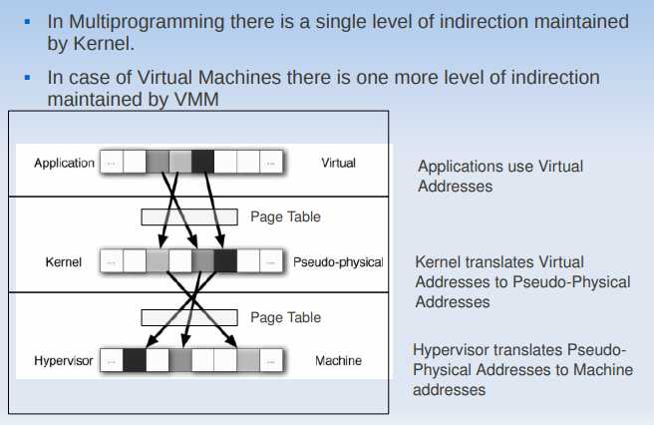
Memory Sharing

Slide 40
IO Sharing
DMA Problem
Device needs to use Physical Memory location.
In a virtualized environment, the kernel is running in a hypervisor provided virtual address space
Allowing the guest kernel to convey an arbitrary location to device for writing is a serious security hole
Detecting a DMA instruction is nontrivial. Each device defines its own protocol for talking to drivers.
XEN Follows Split Driver Model: Dom 0 does the IO on behalf of all the other guests.
As DOM0 is privileged the IO has no problem

Slide 41
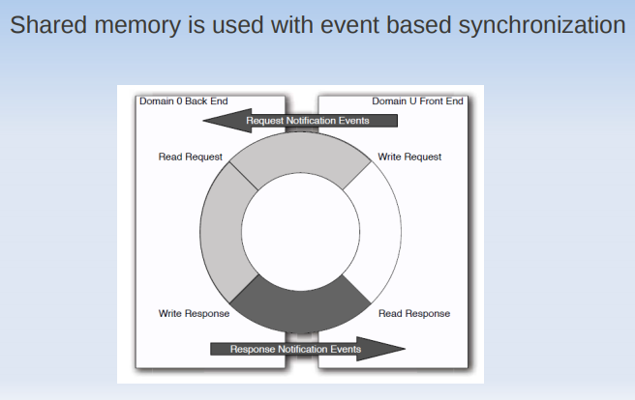
IO Ring

Slide 42
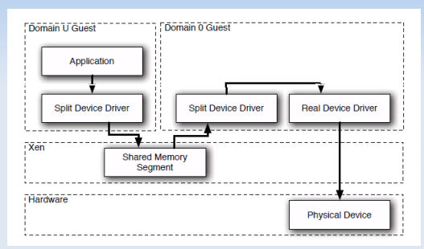
XEN IO Split Device Driver

Slide 43
Conclusions
Notion of Cloud is possible without Virtualization, but it will be inefficient and inflexible.
Virtualization is an attempt to manage OS.
There are many levels and many ways to
implement Virtualization.

Slide 44
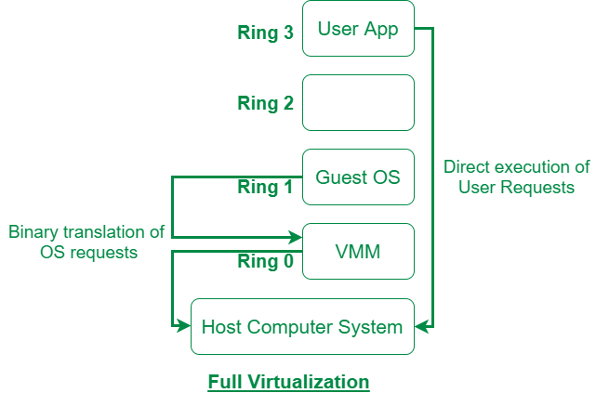
Full Virtualization
Full Virtualization: Full Virtualization was introduced by IBM in the year 1966. It is the first software solution for server virtualization and uses binary translation and direct approach techniques. In full virtualization, guest OS
is completely isolated by the virtual machine from the virtualization layer and hardware
2

Slide 45
ParaVirtualization
Paravirtualization
“Paravirtualization,” found in the XenSource, open source Xen product, attempts to reconcile these two approaches. Instead of emulating hardware, paravirtualization uses slightly altered versions of the operating system which allows access to the hardware resources directly as managed by the hypervisor.
This is known as hardware-assisted virtualization, and improves performance significantly.
In order to retain flexibility, the guest OS is not tied to its host OS. Drastically different operating systems can be running in a hypervisor at the same time, just as they can under full virtualization.
In this way, paravirtualization can be thought of as a low-overhead full virtualization

Slide 46
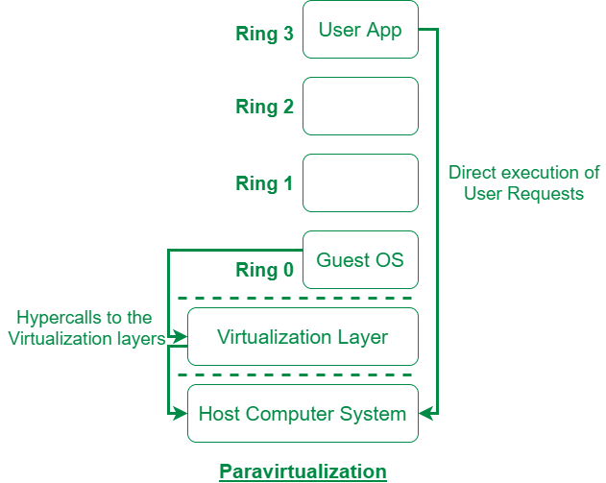
Para Virtualization
Paravirtualization is the category of CPU virtualization which uses hypercalls for operations to handle instructions at compile time. In paravirtualization, guest OS is not completely isolated but it is partially isolated by the virtual machine from the virtualization layer and hardware
2

Slide 47
Approaches for Virtualization
Notes:
RL 2.3

Slide 48
SKI Virtualization
Single Kernel Image (SKI),
Single Kernel Image (SKI), in which the host OS spawns additional copies of itself. This kind of virtualization can be found in Swsoft Virtuozzo and Sun Solaris, Zones. SKI can be thought of as “lightweight” virtualization.
While this approach avoids the performance problems with pure emulation, it does so at the expense of flexibility.
It is not possible, for instance, to run different versions or even different patch levels of a particular operating system on the same machine.
Whatever versions exist in the host, that same software will be provided in the guest. SKI also sacrifices the security and reliability provided by other virtualization methods.

Slide 49
S.No. | Full Virtualization | Paravirtualization
1. | In Full virtualization, virtual machines permit the execution of the instructions with the running of unmodified OS in an entirely isolated way. | In paravirtualization, a virtual machine does not implement full isolation of OS but rather provides a different API which is utilized when OS is subjected to alteration.
2. | Full Virtualization is less secure. | While the Paravirtualization is more secure than the Full Virtualization.
3. | Full Virtualization uses binary translation and a direct approach as a technique for operations. | While Paravirtualization uses hypercalls at compile time for operations.
4. | Full Virtualization is slow than paravirtualization in operation. | Paravirtualization is faster in operation as compared to full virtualization.
5. | Full Virtualization is more portable and compatible. | Paravirtualization is less portable and compatible.
6. | Examples of full virtualization are Microsoft and Parallels systems. | Examples of paravirtualization are Microsoft Hyper-V, Citrix Xen, etc.
7. | It supports all guest operating systems without modification. | The guest operating system has to be modified and only a few operating systems support it.
8. | The guest operating system will issue hardware calls. | Using the drivers, the guest operating system will directly communicate with the hypervisor.
9. | It is less streamlined compared to para-virtualization. | It is more streamlined.
10. | It provides the best isolation. | It provides less isolation compared to full virtualization.
:

Slide 50
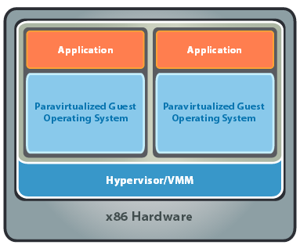
x86 Hardware Virtualization
The latest generation of x86-based systems feature processors with 64-bit extensions supporting very large memory capacities.
This enhances their ability to host large, memory-intensive applications, as well as allowing many more virtual machines to be hosted by a physical server deployed within a virtual infra-structure.
The continual decrease in memory costs will further accelerate this trend.

Slide 51
x86 Hardware Virtualization
For Industry-standard x86 systems, the two approaches typically used with software-based partitioning are
hosted and
hypervisor architectures
A hosted approach provides partitioning services on top of a standard operating system and supports the broadest range of hardware configurations.
In contrast, a hypervisor architecture is the layer of software installed on a clean x86-based system (hence it is often referred to as a “bare metal” approach). Since it has direct access to the hardware resources, a hypervisor is more efficient than hosted architectures, enabling greater scalability, robustness and performance

Slide 52
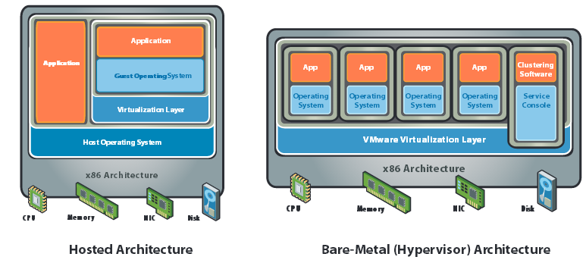
x86 Hardware Virtualization

Slide 53
Advantages of Virtualization
Instant provisioning - fast scalability
Live Migration is possible
Load balancing and consolidation in a Data Center is possible.
Low downtime for maintenance
Virtual hardware supports legacy operating systems efficiently
Security and fault isolation

Slide 54
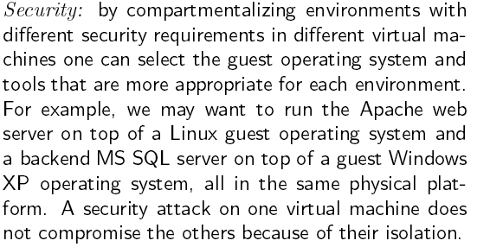
Advantages of Virtualization

Slide 55
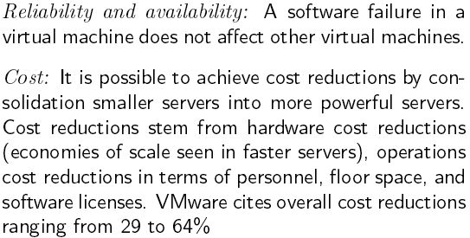
Advantages of Virtualization

Slide 56
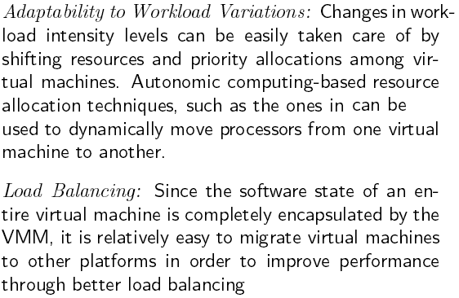
Advantages of Virtualization

Slide 57
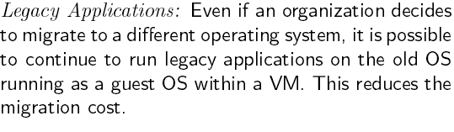
Advantages of Virtualization

Slide 58
Issues to be aware of
Software licensing
One of the most significant virtualization-related issues to be aware of is software licensing. Virtualization makes it easy to create new servers, but each VM requires its own separate software license. Organizations using expensive licensed applications could end up paying large amounts in license fees if they do not control their server sprawl.
IT training
IT staff used to dealing with physical systems will need a certain amount of training in virtualization. Such training is essential to enable the staff to debug and troubleshoot issues in the virtual environment, to secure and manage VMs, and to effectively plan for capacity.
Hardware investment
Server virtualization is most effective when powerful physical machines are used to host several VMs. This means that organizations that have existing not-so-powerful hardware might still need to make upfront investments in acquiring new physical servers to harvest the benefits of virtualization

Slide 59
Issues to be aware of
Interoperability among vendor products is still evolving.
Failure of the virtualization device, leading to loss of the mapping table.

Slide 60
Applications of Virtualization
Today, virtualization can apply to a range of system layers, including hardware-level virtualization, operating system-level virtualization, and high-level language virtual machines.
Maximize resources — Virtualization can reduce the number of physical systems you need to acquire, and you can get more value out of the servers. Most traditionally built systems are underutilized. Virtualization allows maximum use of the hardware investment.
Multiple systems — With virtualization, you can also run multiple types of applications and even run different OS for those applications on the same physical hardware.
IT budget integration — When you use virtualization, management, administration and all the attendant requirements of managing your own infrastructure remain a direct cost of your IT operation.

Slide 61
Technology Trends
Virtualization is Key to Exploiting Trends
Allows most efficient use of the compute resources
Few apps take advantage of 16+ CPUs and huge memory as well as virtualization
Virtualization layer worries about NUMA, not apps
Maximize performance per watt across all servers
Run VMs on minimal # of servers, shutting off the others
Automated, live migration critical:
Provide performance guarantees for dynamic workloads
Balance load to minimize number of active servers
Stateless, Run-anywhere Capabilities
Shared network and storage allows flexible mappings
Enables additional availability guarantees

Slide 62
SKI Virtualization
Single Kernel Image (SKI),
Single Kernel Image (SKI), in which the host OS spawns additional copies of itself. This kind of virtualization can be found in Swsoft Virtuozzo and Sun Solaris, Zones. SKI can be thought of as “lightweight” virtualization.
While this approach avoids the performance problems with pure emulation, it does so at the expense of flexibility.
It is not possible, for instance, to run different versions or even different patch levels of a particular operating system on the same machine.
Whatever versions exist in the host, that same software will be provided in the guest. SKI also sacrifices the security and reliability provided by other virtualization methods.

Slide 63
x86 Hardware Virtualization
The latest generation of x86-based systems feature processors with 64-bit extensions supporting very large memory capacities.
This enhances their ability to host large, memory-intensive applications, as well as allowing many more virtual machines to be hosted by a physical server deployed within a virtual infra-structure.
The continual decrease in memory costs will further accelerate this trend.

Slide 64
x86 Hardware Virtualization
For Industry-standard x86 systems, the two approaches typically used with software-based partitioning are
hosted and
hypervisor architectures
A hosted approach provides partitioning services on top of a standard operating system and supports the broadest range of hardware configurations.
In contrast, a hypervisor architecture is the layer of software installed on a clean x86-based system (hence it is often referred to as a “bare metal” approach). Since it has direct access to the hardware resources, a hypervisor is more efficient than hosted architectures, enabling greater scalability, robustness and performance

Slide 65
x86 Hardware Virtualization

Slide 66
Advantages of Virtualization
Instant provisioning - fast scalability
Live Migration is possible
Load balancing and consolidation in a Data Center is possible.
Low downtime for maintenance
Virtual hardware supports legacy operating systems efficiently
Security and fault isolation

Slide 67
Terminologies to remember
Basic technique of virtualization is – Trap and Emulate Virtualization
Privilege levels or protection ring
CPL – Current Privilege Level (Guest OS)
Instruction Types – Behavior sensitive, Control sensitive
Control sensitive (privileged instructions)
Method of virtualization – Binary Translation
Para virtualization (Hypervisor dependent)

Slide 68
Advantages of Virtualization

Slide 69
Advantages of Virtualization

Slide 70
Advantages of Virtualization

Slide 71
Advantages of Virtualization

Slide 72
Issues to be aware of
Software licensing
One of the most significant virtualization-related issues to be aware of is software licensing. Virtualization makes it easy to create new servers, but each VM requires its own separate software license. Organizations using expensive licensed applications could end up paying large amounts in license fees if they do not control their server sprawl.
IT training
IT staff used to dealing with physical systems will need a certain amount of training in virtualization. Such training is essential to enable the staff to debug and troubleshoot issues in the virtual environment, to secure and manage VMs, and to effectively plan for capacity.
Hardware investment
Server virtualization is most effective when powerful physical machines are used to host several VMs. This means that organizations that have existing not-so-powerful hardware might still need to make upfront investments in acquiring new physical servers to harvest the benefits of virtualization

Slide 73
Issues to be aware of
Performance can be a concern, especially for in-band deployments, where the virtualization controller or appliance can become a bandwidth bottleneck.
Interoperability among vendor products is still evolving.
Failure of the virtualization device, leading to loss of the mapping table.

Slide 74
Applications of Virtualization
Today, virtualization can apply to a range of system layers, including hardware-level virtualization, operating system-level virtualization, and high-level language virtual machines.
Maximize resources — Virtualization can reduce the number of physical systems you need to acquire, and you can get more value out of the servers. Most traditionally built systems are underutilized. Virtualization allows maximum use of the hardware investment.
Multiple systems — With virtualization, you can also run multiple types of applications and even run different OS for those applications on the same physical hardware.
IT budget integration — When you use virtualization, management, administration and all the attendant requirements of managing your own infrastructure remain a direct cost of your IT operation.

Slide 75
Benefits of using Virtual Machines
Instant provisioning - fast scalability
Live Migration is possible
Load balancing and consolidation in a Data Center is possible.
Low downtime for maintenance
Virtual hardware supports legacy operating systemsefficiently
Security and fault isolation

Slide 76
XEN Hypercall

Slide 77
Memory Sharing

Slide 78
IO Sharing
DMA Problem
Device needs to use Physical Memory location.
In a virtualized environment, the kernel is running in a hypervisor provided virtual address space
Allowing the guest kernel to convey an arbitrary location to device for writing is a serious security hole
Detecting a DMA instruction is nontrivial. Each device defines its own protocol for talking to drivers.
XEN Follows Split Driver Model: Dom 0 does the IO on behalf of all the other guests.
As DOM0 is privileged the IO has no problem

Slide 79
IO Ring

Slide 80
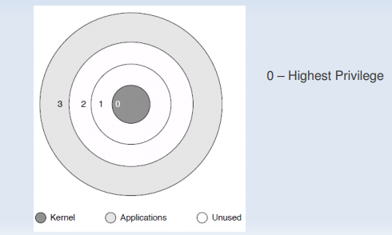
Privilege Rings
Memory page has a 2 bit code which is checked by CPU before executing the instruction.
If privilege level is insufficient the CPU does not executes the Instruction.

Slide 81
XEN IO Split Device Driver

Slide 82
Conclusions
Notion of Cloud is possible without Virtualization, but it will be inefficient and inflexible.
Virtualization is an attempt to manage OS.
There are many levels and many ways to
implement Virtualization.

Slide 83
Virtualization Architecture
Hosted Architecture.
Bare-Metal Architecture

Slide 84
Hosted Architecture
In this architecture, host operating system is first installed.
A piece of software called a hypervisor or virtual machine monitor (VMM) is installed on top of the host OS.
It allows users to run various guest operating systems within their own application windows.
Eg. VMware Workstation, Oracle Virtual Box , Microsoft Virtual PC

Slide 85
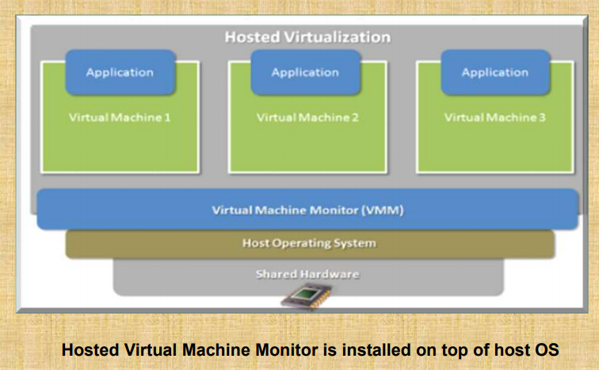
Hosted Architecture

Slide 86
Hosted Architecture( Pros & Cons)
Advantage
Ease of installation and configuration.
Unmodified Host OS & Guest OS.
Run on a wide variety of pc.
Disadvantage
performance degradation.
lack of support for real-time operating systems.

Slide 87
Bare-Metal Architecture
In this architecture, type1 hypervisor or VMM is
installed on the bare hardware.
VMM communicates directly with system hardware rather than relying on a host operating system.
E.g: VMWARE ESX, VMWARE ESXi, Microsoft Hyper-V

Slide 88
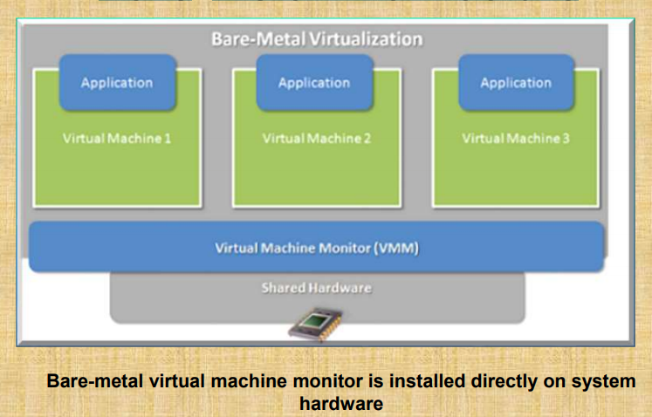
Bare-Metal Architecture

Slide 89
Bare-Metal Architecture (Pros & Cons)
Advantages
Improved I/O Performance.
Support Real Time OS.
Disadvantage
Difficult to install & Configure.
Depends upon hardware platform.

Slide 90
FULL VIRTUALIZATION
(What is ?)
It is a virtualization technique used to provide a virtual machine environment which is a complete simulation of the underlying hardware.
All operating systems and applications which can run natively on the hardware can also be run in the virtual machine.
The guest OS need not be modified.
Guest OS do not aware the existence of VM.
Each VM is independent of each other

Slide 91
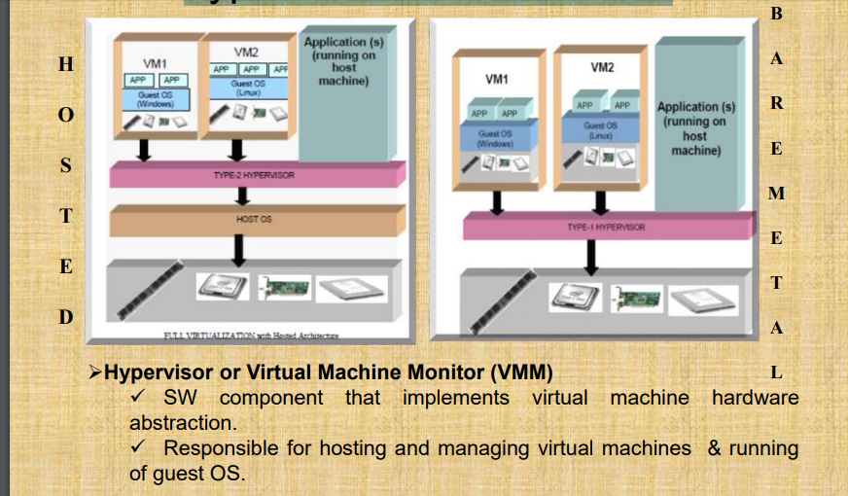
Types of Full Virtualization

Slide 92
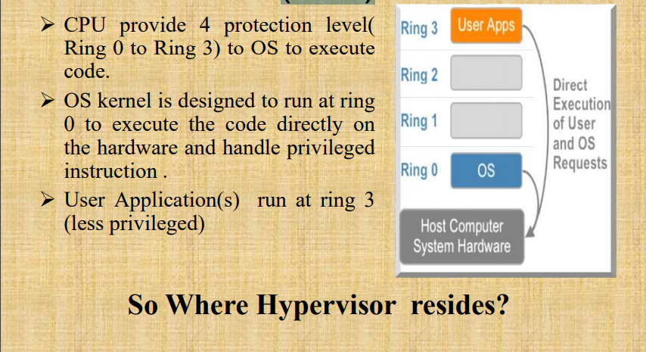
virtualization – Challenges (X86)

Slide 93
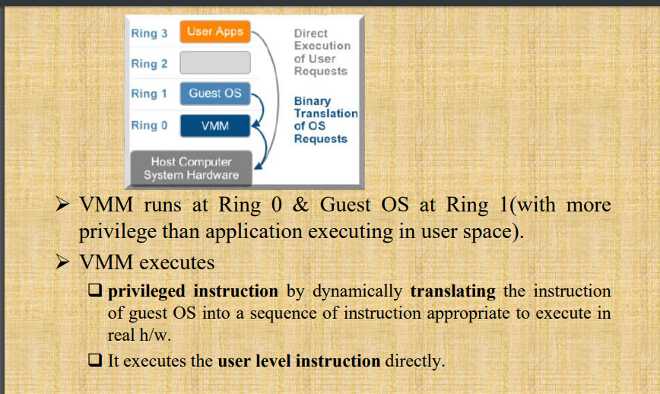
Binary Translation in Full Virtualization

Slide 94
Full Virtualization – Advantages & Disadvantage
Advantage
Secure
✓The emulation layer isolates VMs from the host OS & other application (s).
Total VM portability
The emulating h/w interface & guest Os forms a standard package that can be ported & run in any platform.
Run unmodified OS
Guest OS do not aware of being virtualized.
Disadvantage
Performance degradation in hosted full virtualization.
Hardware dependency in bare-metal full virtualization.

Slide 95
Application of Full Virtualization
➢ Hosted Full Virtualization is used for Desktop Virtualization.
➢Eg: Microsoft Virtual PC & Oracle VM Virtual Box.
➢ Bare-Metal Full Virtualization is used for Server Virtualization.
➢Microsoft Hyper-V and VMware ESX Server.
➢ Server Virtualization is used in Cloud Computing.

Slide 96
Implementation of Full virtualization (Hosted Architecture)
Platform
Hardware
Intel® Core™2 Duo CPU
2 GB RAM
160 GB HDD
Software
Windows 7 as Host OS.
Windows XP & LINUX as Guest OS.
Oracle VM Virtual Box.

Slide 97
Implementation of Full virtualization (Hosted Architecture)
Step1: Install Microsoft Virtual PC ( type2 Hypervisor).
Step2: Create VM1 with winxp (sp2) as guest OS &
VM2 with Linux as guest OS.
Step3: Install your desired application on guest OS

Slide 98
Conclusion
The future of enterprise IT management will be based
on virtual computing. Intel® VT makes it possible to
maximize computer utilization while minimizing all
associated overheads of management, power
consumption, maintenance and physical space.
Virtualization also allows the industry to run business
with fewer machine and at reduced cost while
providing the infrastructure to meet customer needs.

Slide 99
OS and Virtualization Difference
Host OS uses the actual hardware for the working whereas the Guest OS uses the virtual hardware like number of cores and type and size of hard drive defined by the user while adding a virtual machine. ... Linux operating systems are multi-threaded operating system. The host OS would consider virtual box as a thread.
First of all there aren't any specific number of process for an OS, its called as cores or threads, technically you can define how many cores or threads you want to use on your virtual machine and it depends on the system configuration you use.
Secondly Guest OS is what you have created in the virtual machine and host is what your laptop or pc actually run. Host OS uses the actual hardware for the working whereas the Guest OS uses the virtual hardware like number of cores and type and size of hard drive defined by the user while adding a virtual machine.
Third, as I mentioned earlier Guest and Host OS works on the configurations used by you, if you user higher amount of cores/ threads in setting your virtual machine the Guest OS will get higher speed
Kernel - a program whose purpose is control and multiplexing of hardware for the benefit of other programs. ... Hypervisor - a program whose purpose is control and multiplexing of hardware for other kernels. Typically runs at an even higher privileged level than a kernel, which was invented for this purpose

Slide 100
Comparison of different Server Virtualization software
Citrix XenServer
XenServer is an open sourced product from Citrix, based on Xen Project Hypervisor. It’s a bare-metal virtualization platform with enterprise-grade features that can easily handle workloads, combined OS, and networking configurations. XenServer delivers application performance for x86 workloads in Intel and AMD environments.
It can cater to XenApp and XenDesktop deployments, and offer customers the enhanced virtualized graphics with NVIDIA and Intel. XenServer services allow multiple computer operating systems to execute on same computer hardware

Slide 101
Microsoft Hyper-V
Microsoft introduced its hypervisor in 2008, and has continued to release new versions along with the new Windows servers. Hyper -V helps one expand or establish a private cloud environment, promotes effective hardware utilization, improves business continuity and makes development and testing more efficient. We have discussed some features for Windows Server 2019 here.

Slide 102
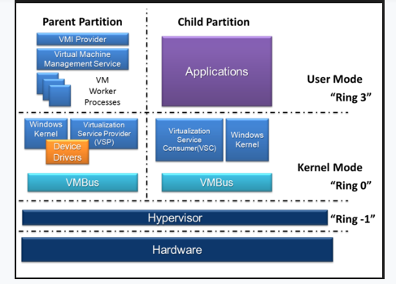
Microsoft Hyper V
Features:
Persistent memory support.
Shielded VM updates.
Simple Two-Node clusters.
ReFS Deduplication.
Storage Spaces Direct improvements.
Windows Admin Center.
Encrypted subnets.

Slide 103
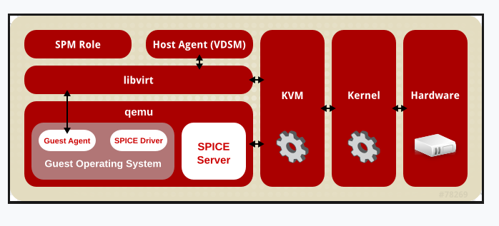
Red Hat KVM (Kernel-based Virtual Machine)
Red Hat’s KVM is a complete virtualization infrastructure solution. Kernel-based Virtual Machine turns Linux kernel into a hypervisor. A part of Red Hat Virtualization suite, it was merged into the Linux kernel mainline in kernel version 2.6.20.
Here is an overview of the features of KVM:
Scalability.
Overcommit resources.
Disk I/O throttling.
Hot plug of virtual resources.
Low cost virtualization solution.
Red Hat Enterprise Virtualization programming & API.
Live Migration & Storage Migration.
Assign any PCI device to virtual machines.
Container support.
Disaster Recovery support.
Red Hat Satellite integration

Slide 104
RedHat KVM

Slide 105
VMware Vsphere
VMware vSphere
VMware vSphere is a set of server virtualization products that includes virtualization, management, and interface layers. It comprises following core components- infrastructure services, including VMware vCompute, vStorage and vNetwork; application services; vCenter Server – single point control across datacenter services; and clients who can access the data center via vSphere Client or via a web browser.

Slide 106
What Is a Bare Metal Server?
A bare metal server is a physical hosting device dedicated to a single client (tenant). Typically set up on-prem or at a third-party data center (either rented or via colocation), a bare metal server can process more data than any other hosting solution as the user has exclusive use of all computing resources, including:
CPU.
RAM.
Disk space.
Bandwidth.
Besides fully dedicated computing resources, other main reasons why companies choose a bare metal server are:
High levels of processing power.
Consistent input/output operations per second (IOPS).
High data privacy due to the lack of other tenants.
Complete control over the server's hardware and the software stack.
Predictable billing (typically monthly).
If your app is sensitive to performance and you wish to store data at a single-tenant device, the benefits of bare metal are hard to beat.

Slide 107
What Is a Virtual Machine (VM) Server?
A VM server is a software-based hosting setup that runs in a multi-tenant environment within a single device. Splitting a machine into individual VMs requires server virtualization, a process that enables a device to host multiple systems while sharing the same physical resources (disk space, RAM, and CPU).
Data centers create shared-resource servers using a hypervisor. A hypervisor parcels the server into distinct units that rely on the same components but have separate OSs, apps, and networking. To learn more about how hypervisors and virtualization work, refer to our article on types of hypervisors.
Most companies that choose a VM server over other hosting solutions do so because of the following reasons:
Quick and simple deployments.
Flexibility to add more server resources in times of high usage and match fluctuating traffic demands.
Ability to control and optimize costs through a pay-as-you-go model.
Little to no hardware-related server management.
Quick and reliable snapshots and backups.
VM servers are ideal for dynamic workloads and non-mission-critical apps that prioritize flexibility over consistently high performance

Slide 108
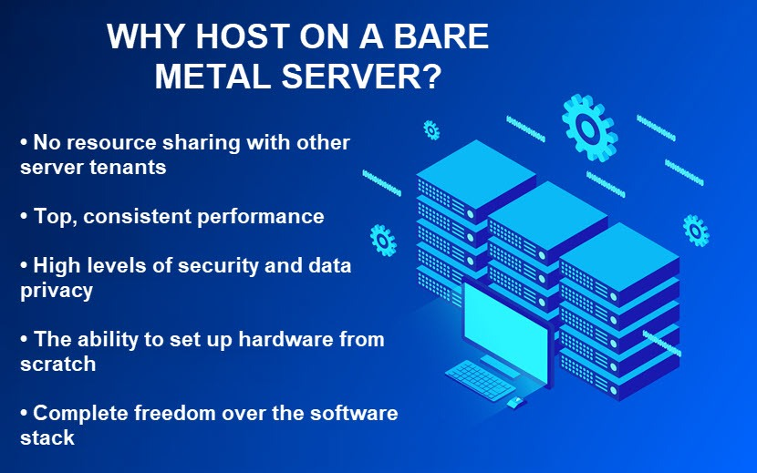

Slide 110
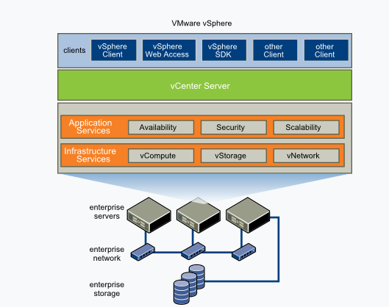
Features and components:
It abstracts memory, processors, storage and other resources into multiple VMs.
vCenter Server: Centralized management tool to configure, provision and manage virtual IT environments. Provides data center services like alarm management, access control to ESXi hosts.
vSphere Client: vSphere 6.7 has the final version of Flash-based vSphere Web Client. Newer workflows in the updated vSphere Client release includes vSphere Update Manager, Content library, vSAN, Storage policies, Host profiles, VMware vSphere Distributed Switch™ topology diagram and Licensing.
vSphere SDKs: Provides interfaces for third-party solutions to access vSphere.
VM File System: A cluster file system for VMs.
Virtual SMP: Enables a single VM to use multiple physical processors at a time.
vMotion: Enables live migration with transaction integrity.
Storage vMotion: Enables VM file migration from one place to other without service interruption.
High Availability: If one server fails, VM is shifted to another server with spare capacity to enable business continuity.
Distributed Resource Scheduler (DRS): Assigns and balances compute automatically across hardware resources available for VMs.
Fault Tolerance: Generates copy of primary VM to ensure its continuous availability.
Distributed Switch (VDS): Spans multiple ESXi hosts and enables considerable reduction of network maintenance activities and increases network capacity.
Network & Storage I/O Control.
Hot add CPU and RAM resources

Slide 111
VMware VSphere

Slide 112
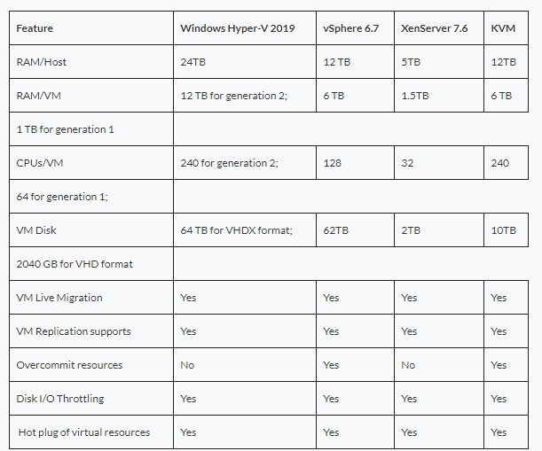
Hypervisor Comparison 2019: KVM vs Hyper-V vs XenServer vs vSphere

Slide 113
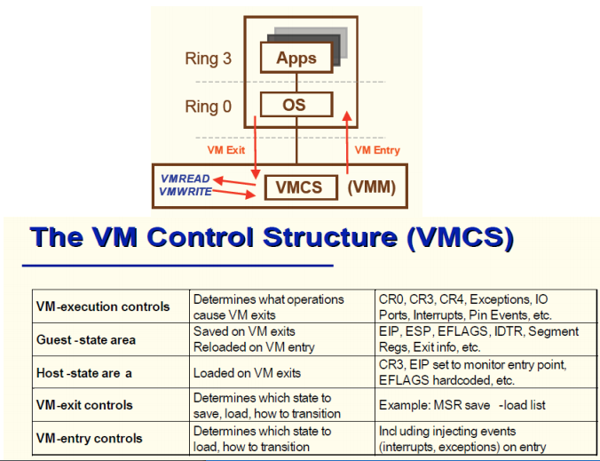
VM Control Structure

Slide 114
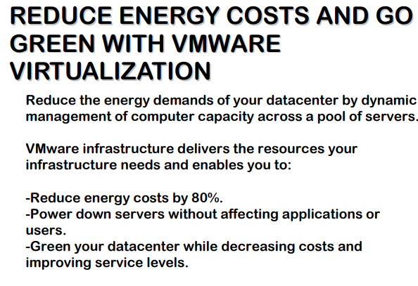
Virtualization Benefits

Slide 115
What Is a Bare Metal Server?
A bare metal server is a physical hosting device dedicated to a single client (tenant). Typically set up on-prem or at a third-party data center (either rented or via colocation), a bare metal server can process more data than any other hosting solution as the user has exclusive use of all computing resources, including:
CPU.
RAM.
Disk space.
Bandwidth.
Besides fully dedicated computing resources, other main reasons why companies choose a bare metal server are:
High levels of processing power.
Consistent input/output operations per second (IOPS).
High data privacy due to the lack of other tenants.
Complete control over the server's hardware and the software stack.
Predictable billing (typically monthly).

Slide 117
What Is a Virtual Machine (VM) Server?
A VM server is a software-based hosting setup that runs in a multi-tenant environment within a single device. Splitting a machine into individual VMs requires server virtualization, a process that enables a device to host multiple systems while sharing the same physical resources (disk space, RAM, and CPU).
Data centers create shared-resource servers using a hypervisor. A hypervisor parcels the server into distinct units that rely on the same components but have separate OSs, apps, and networking. To learn more about how hypervisors and virtualization work, refer to our article on types of hypervisors.
Most companies that choose a VM server over other hosting solutions do so because of the following reasons:
Quick and simple deployments.
Flexibility to add more server resources in times of high usage and match fluctuating traffic demands.
Ability to control and optimize costs through a pay-as-you-go model.
Little to no hardware-related server management.
Quick and reliable snapshots and backups.
VM servers are ideal for dynamic workloads and non-mission-critical apps that prioritize flexibility over consistently high performance.

Slide 118
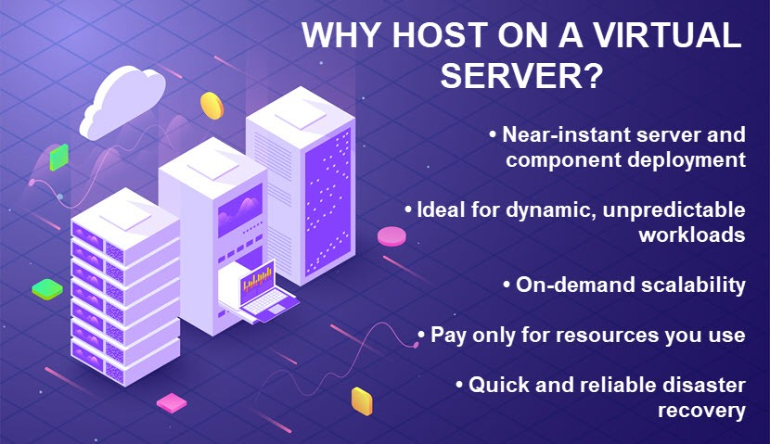

Slide 119
Bare Metal Vs VM Servers (Comparison Table)
The table below offers a high-level overview of the main differences between bare metal and VM servers:
POINT OF COMPARISON | BARE METAL SERVER | VM SERVER
Main selling points | Consistent performance and complete data privacy | Near-instant scalability and cost optimization options
Hardware dedication | All server resources (CPU, RAM, memory, bandwidth) belong to a single user | Tenants host on the same device and share server resources
Performance capabilities | Consistently high performance | Less consistent performance due to multiple tenants
Customization options | The tenant has complete freedom when setting up both hardware and software | Fewer software customization options due to the shared nature of the server
Deployment time | Takes time to set up a new server (hours for a rented device, days for an on-prem server) | New deployments are a matter of a few minutes
Hardware maintenance | Complex without managed services | No hardware maintenance
Scalability | Scaling up or down requires months for on-prem servers, hours for rented devices | Near-instant, on-demand scalability (both up and down)
Capacity optimization | Limited capacity optimization | Advanced capacity optimization enabled by load balancing
Security | Customization options and single tenancy ensure a secure IT platform | Other tenants can cause security and privacy concerns
System recovery | Recovering from a mid-size disaster can take hours or even days | Recovering from a disaster happens in minutes
Server portability | Moving a physical server is a complex and lengthy task | You can easily move a VM across virtual environments or from one physical server to another
Typical billing methods (for a rented server) | A predictable (typically monthly) bill | Charges based on how much resources you use
On-prem expenses | High upfront costs for hardware and space (but no need for licensing purchase) | Smaller hardware costs but pricey VM software licenses

Slide 120
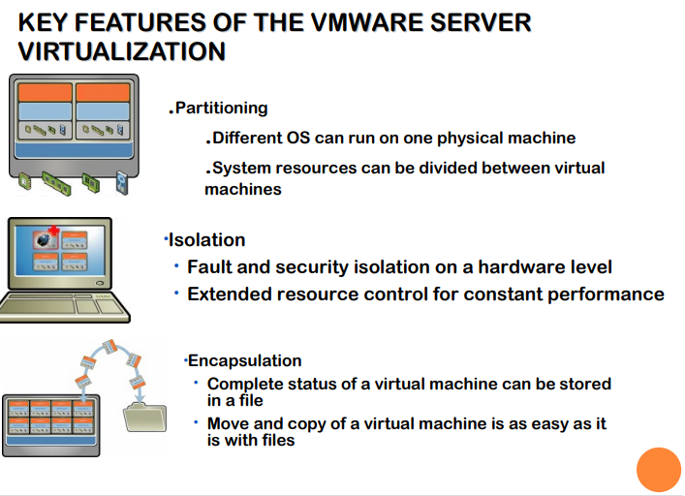
VMware Server Virtualization Features

Slide 121

Hypervisor types

